Slide 1
Machine Learning for Electrode Motion Artefact removal in ECG Signals
By
Ben Russell
23/09/2024

Slide 2

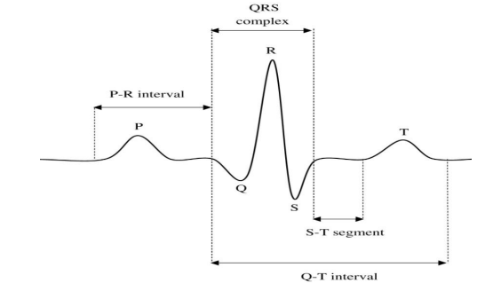
Problem Statement
Electrocardiogram (ECG) signals provide a means to monitor the electrical activity of an individual's heart.
Algorithmic processing of the ECG can provide valuable information on heart health, and detect abnormalities (Atrial Fibrillation, Tachycardia etc..)
Generally, requires continuous monitoring of the ECG over a long time period, requiring uses to wear acquisition devices during their normal day.
ECG data acquired outside of a hospital setting can be corrupt be a significant amount of noise.

Slide 3
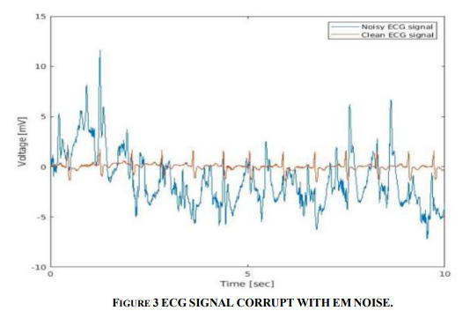
Problem Statement
Noise will almost certainly block diagnostic features within the ECG, meaning significant amounts may have to be discarded.
This is wasteful and may mean that any abnormal heart rhythms/beats may go undetected by downstream algorithms.
ECG signals are affected by both linear and non-linear noise artefacts.
Most noise artefacts can be mitigated through the use of digital filters, however these are inadequate for non-linear noise.
Of the non-linear noise sources, Electrode Motion is the most problematic.

Slide 4
What is Electrode Motion?
Electrode Motion is a type of noise introduced by the movement of electrodes on the skin, which distorts the underlying electrical signal.
It is both non-linear, and non-stationary making traditional digital filters unsuitable for its removal.
Adaptive filters have been shown the be the most effective, however these usually require access to one or more reference signals (accelerometer etc..)
The performance of adaptive filters is limited, in some cases it can only restore the signal at high Signal To Noise Rations (18dB)

Slide 5
The Solution
Traditional signal processing methods like filters are often limited by their linearity. Deep learning models can capture complex, non-linear relationships between noise and the true signal, allowing for more accurate denoising.
However, unlike traditional methods, the performance of deep learning models is largely dependent on the quality of data it is trained on.
Therefore, the development of a large and highly varied database is necessary.

Slide 6
Methodology (Clean Signal Generation)
The following requirements were deemed critical:
Clean Signal Variability – Each clean signal generated shall have different waveform parameters (Width, amplitude and slope of PQRST)
Clean Signal Realism – Each clean signal generated shall have waveforms that are realistic and may be seen in real life.
Heart Rate Coverage– Each clean signal shall have copies generated at different heart rates.
All clean signals shall be generated at 500Hz sampling frequency.

Slide 7
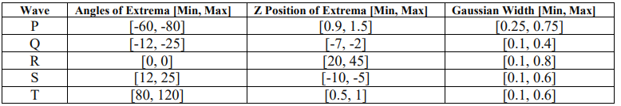
Methodology (Clean Signal Generation)
ECG signals were generated by an online tool, called ECGSYN.
ECGSYN models the electrical activity from the heart (Lead II) position based on 3 ordinary differential equations.
To generate an ECG, the algorithm requires the following inputs:
Angles of Extrema for P, Q, R, S and T waves.
Z Position of Extrema for P, Q, R, S, and T waves.
Gaussian Width for P, Q, R, S and T waves.
The [Min , Max] values are set arbitrarily to provide a large range for each feature.
These get filtered, to only provide realistic signals.

Slide 8
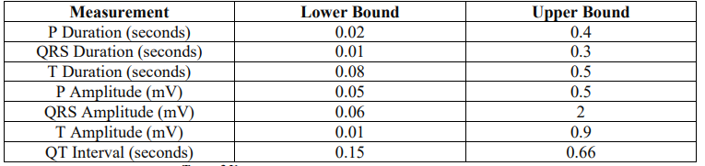
Methodology (Clean Signal Filtering)
An iterative process using Latin Hypercube Sampling is followed to generate a large amount of clean signal for each HR (10,000 signals per HR)
The generated signals are then validated before getting transferred to a ‘master’ database.
An algorithm was designed to detect the boundary and peak locations within each ECG.
If the ECG contained any measurements that fell outside a realistic range, it was discarded.
Wagner GS (2014), Marriott’s Practical Electrocardiography

Slide 9

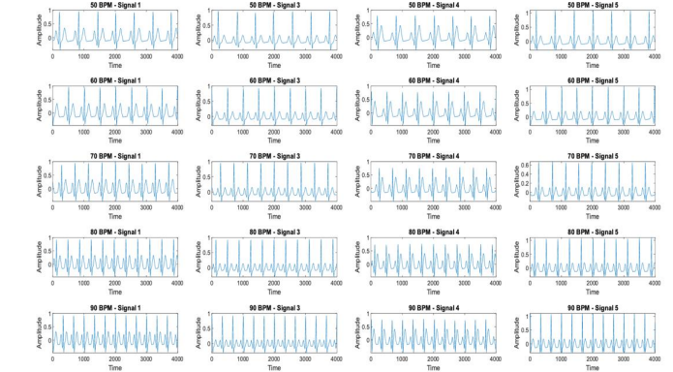

Methodology (Clean Signal Examples)
Clean Signals are generated at 5 different Heart Rates. (Each Row)
The individual morphologies can be seen to change on each signal, ensuring that no clean signal is the same.
Visually inspecting the signals, they are realistic and could be deemed acceptable by an observer. Originally this was a problem in the experiment.

Slide 10
Methodology (Noise Signal Generation)
The following requirements were deemed critical:
All noise signals shall be representative of Electrode Motion noise.
Original noise signals shall be extracted from Physionet database.
Ten copies of noise shall be modelled through an Autoregressive (AR) model.
All noise signals shall contain similar statistical properties to that of a real noise signal.
All noise signals shall be scaled to 0, 6, 12, 18 and 24dB. (Relative to clean signal)
All noise signals shall be linearly added to each clean signal, to generate a large database of electrode motion corrupt ECG signals.

Slide 11
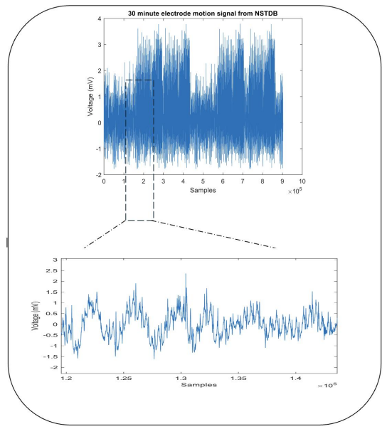
Methodology (Noise Signal Generation)
Physionets’ Noise Stress Test (NST) database contains a 30-minute record of pure Electrode Motion Noise.
This signal was extracted and passed through a bandpass filter to remove respiration noise (<1Hz).
The signal was segmented into Ten 30 second files.
Each 30 second noise record was passed through a 300th order Autoregressive (AR) model to predict 10 copies of noise with similar statistical properties.
This produced 110 noise signals per clean signal.

Slide 12
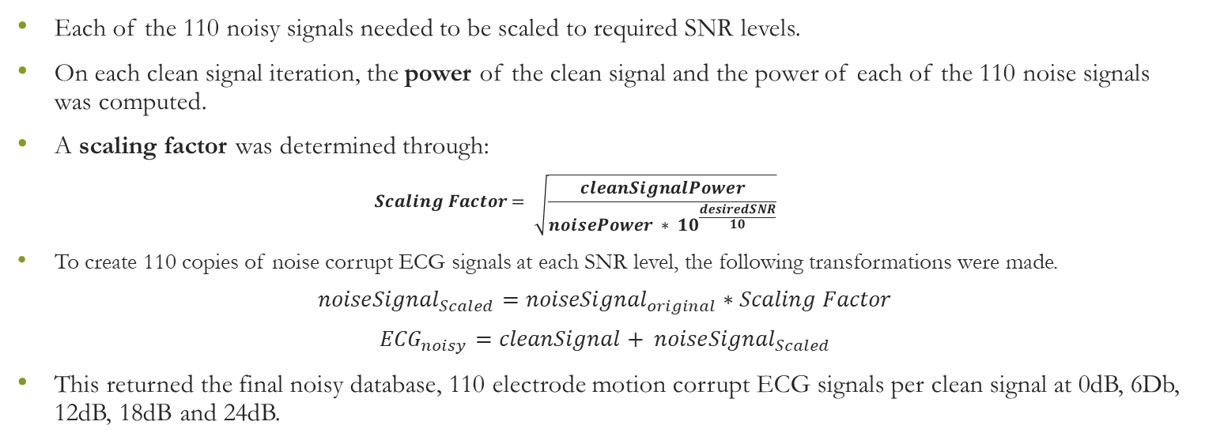
Methodology (Noise Signal Generation)
Each of the 110 noisy signals needed to be scaled to required SNR levels.
On each clean signal iteration, the power of the clean signal and the power of each of the 110 noise signals was computed.
A scaling factor was determined through:
$$Scaling Factor= \sqrt{\frac{cleanSignalPower}{noisePower ∗ {10}^{\frac{desiredSNR}{10}}}}$$
To create 110 copies of noise corrupt ECG signals at each SNR level, the following transformations were made.
$${noiseSignal}_{Scaled}={noiseSignal}_{original}∗Scaling Factor$$
$${ECG}_{noisy}=cleanSignal+ {noiseSignal}_{Scaled}$$
This returned the final noisy database, 110 electrode motion corrupt ECG signals per clean signal at 0dB, 6Db, 12dB, 18dB and 24dB.

Slide 13
Methodology (Deep Learning Models)
Three Deep Learning structures were identified as promising for time-series denoising:
Convolutional Neural Networks
Recurrent Neural Networks
Denoising Auto-encoders
All three structures were implemented on Python (Using the PyTorch framework)
70% of the database was used to train the algorithms, and 30% to test.

Slide 14
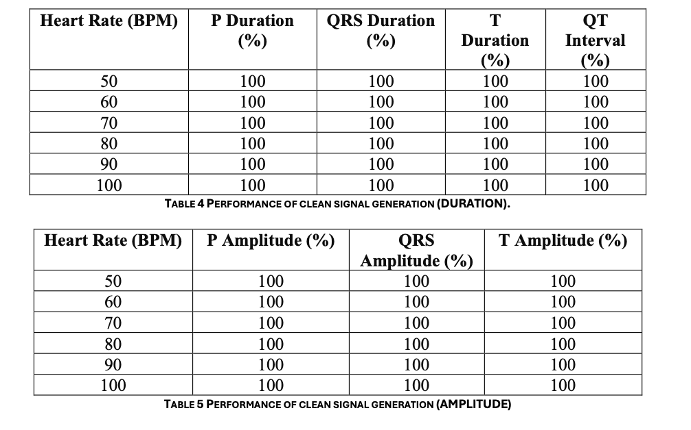
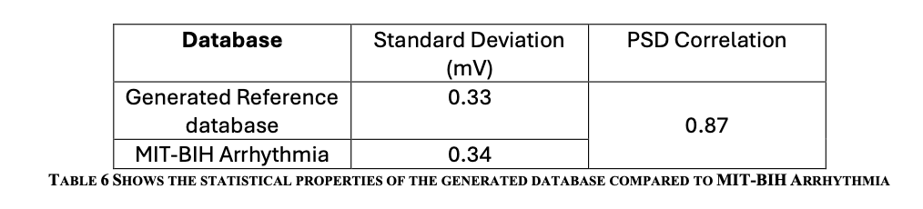
Results (Clean Signals)
All clean signals generated produced waveforms that can be considered realistic.
Clean signals database returned a similar mean Standard Deviation to clean signals in a real database.
The power spectral density of the simulated dataset was highly correlated to that of a real database.

Slide 15
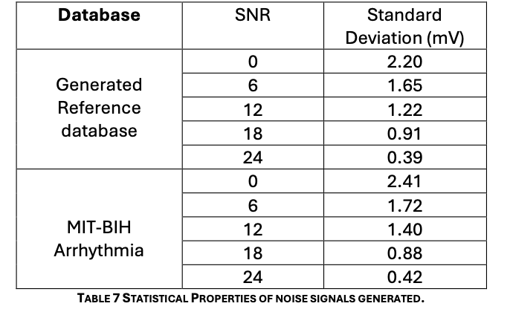
Results (Noisy Signals)
The standard deviation of the noisy signals were comparable to the same SNR in the real database.
Consistently high correlation values in the PSD of 0.82, 0.82, 0.84, 0.79 and 0.86 imply a similar frequency content between the simulated and real database.

Slide 16
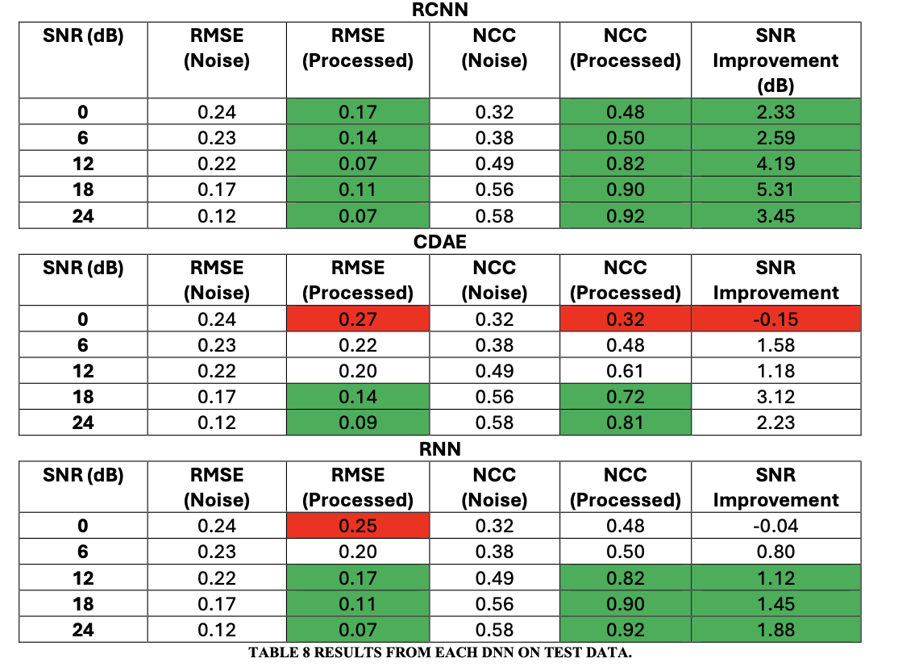
Results (Deep Learning Models)
Convolutional Neural Networks outperformed the other models significantly.
A lower RMSE across all SNR values, higher NCC and higher SNR improvement shows how the CNN can eliminate more noise and retain more of the underlying ECG signal.
CDAE and RNN struggled at low SNR values, caused by the models identifying large noise spikes and QRS peaks.

Slide 17
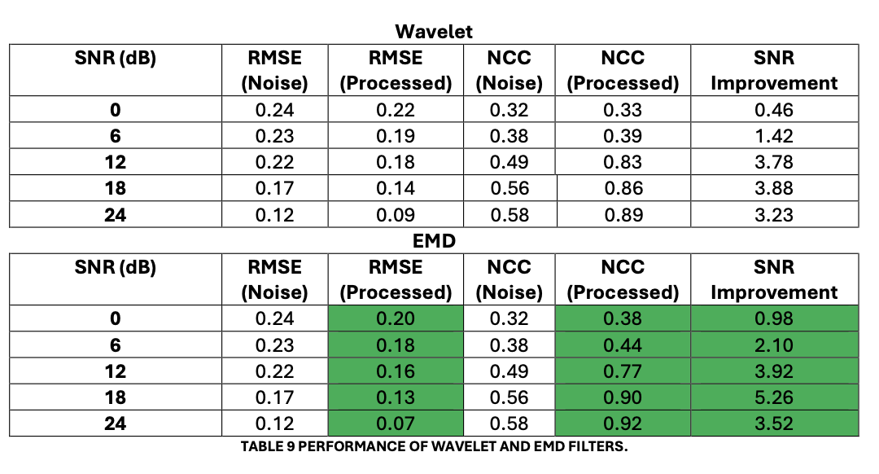
Results (Traditional Filters)
Out of the two most common traditional filters, EMD performed best.
However, its’ performance was exceeded by the RCNN model in all metrics.

Slide 18
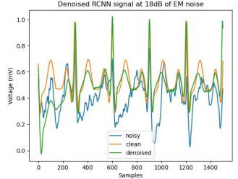
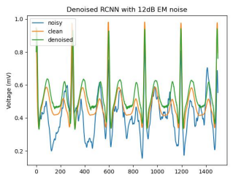
Example Plots (RCNN)

Slide 19
Advantages of the framework
Current DL solutions for denoising ECG signals utilize ~40 records from the MIT-BIH database.
They corrupt 30-second signals with 30 seconds of noise from NST database.
This is a small dataset, that misses a lot of the potential shapes on:
ECG signal morphology variance
Electrode Motion Variance (Which is massive)
The methodology presented in this work may be a starting point to generate a large and expansive DL training set to help algorithms generalize to electrode motion seen in real world settings.
The methodology presented in this work uses on Data Augmentation techniques, meaning that little/no data collection is required. (Which is extremely challenging for ECG noise)
The methodology in this work can be fully automated, providing a robust means to develop, test and monitor new/existing DL solutions.

Slide 20
Further Work
There are several additional pieces of work that could be added to this framework:
Abnormal ECG beats – Addition of more complex ECG beats is essential as this will affect the performance of noise removal around abnormal beats.
Range of ECG rhythms – Current work assumes a fixed rhythm per HR. The addition of Tachycardia, Atrial Fibrillation, Bigeminy etc would help models generalise to real data.
Results comparison to standard databases – The performance of each of the network parameters generated by the framework should be used to evaluate performance on MIT-BIH database.
Exploration of two more recent developments in the field would potentially improve performance, Generative Adversarial Networks (GAN’s) and Physics Informed Neural Networks (PINNs)

